Slide 1

Building Rental Property Dataset Using Web Scraping
By Madhu, Karthikreddy, Pradeep, Varun

Slide 2
Table of contents
Background
Objective
Terms for Scraping
Constructed Dataset
Scraping Flow
Future Scope

Slide 3

Background
Finding the best apartments based on individual requirements can sometimes becomes a cumbersome task. The complexity furthermore increases if a person lives in any of most popular cities.
We wanted to figure out a way in order to address this problem and succeeded using web scraping technique for APARTMENTS.COM website.

Slide 4

Objective:
Scrape rental property website
Build the dataset with relevant attributes for Philadelphia
Extended the dataset to other cities as well
The obtained dataset can be used for further analysis, like for making predictions

Slide 5
Scraping Flow
Extract List Of Cities
Navigate To A City Main Page
Capture Property URL's
Trigger Each URL
Scrape The Required Fields

Slide 6
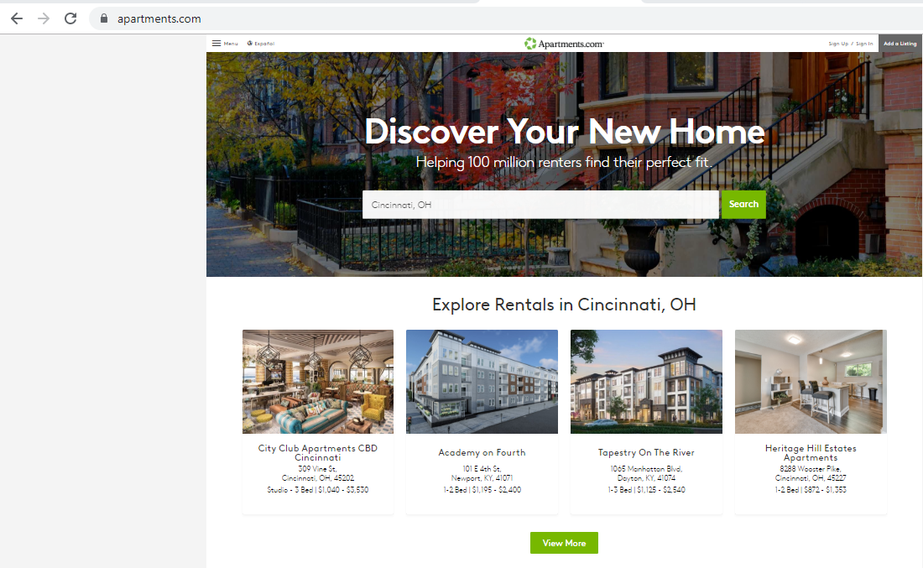
Home Page
view of
Apartments.com

Slide 7
Terms for Scraping:
> Apartments.com
> For individual or personal use its legally valid to scrape
> The limitation is, obtained dataset cannot be published or shared without their consent
> Also its prohibited for any commercial usage.

Slide 8
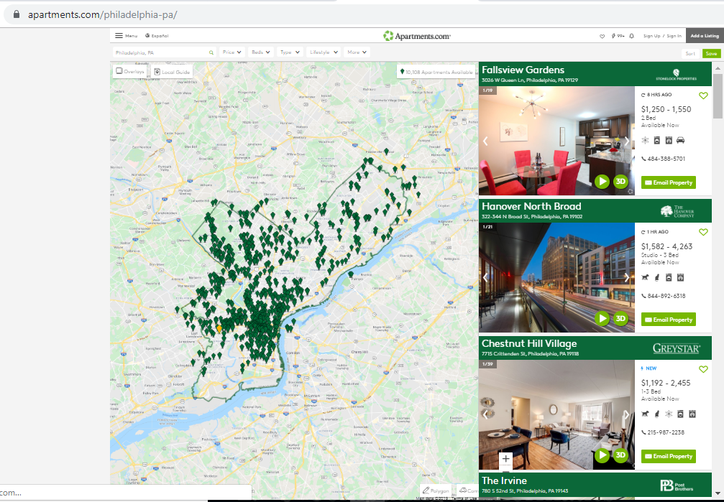

Slide 9
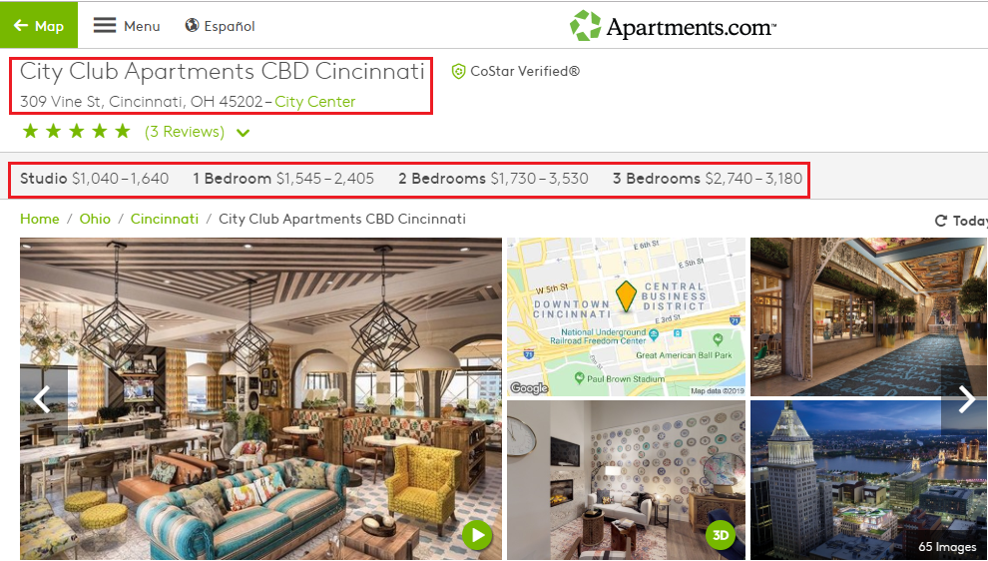

Slide 10
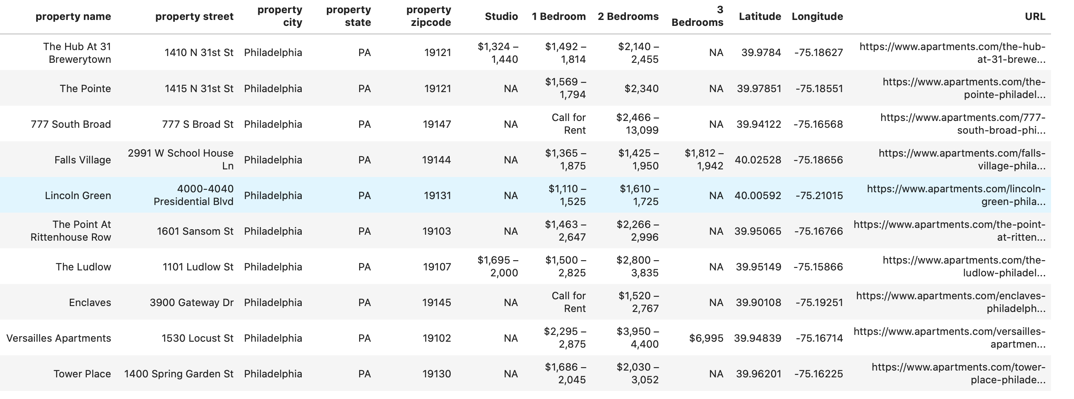
BUILT DATASET:

Slide 11


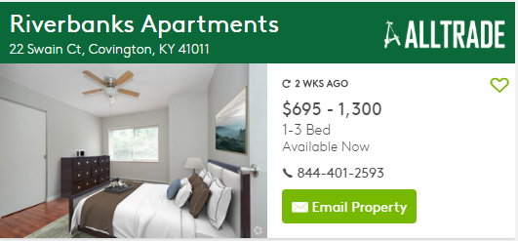

Challenges on main page:
> There wasn’t a common blueprint followed for the hovering of page numbers.
> The individual property logo info was also not aligned in a single format

Slide 12

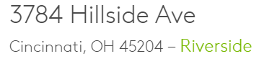
Challenge on individual page:
> Address details in the individual property were different for few properties

Slide 13

Future scope
Extending the dataset with features like
Amenities
User Reviews

Slide 14
Thank you

